Slide 1
Restaurant Reservation System
M S Arifin Khan Ahee | 1421068042
Sazzad Hossain | 1610139042
Md. Rashad Tanjim | 1620952042

Slide 2
Tools used:
Android Studio
PowerPoint
BALSAMIQ OR OTHER UX DESIGN TOOLS.
Piazza (For communication)
GIT (GITHUB)
TRELLO
Microsoft word/EXCEL

Slide 3
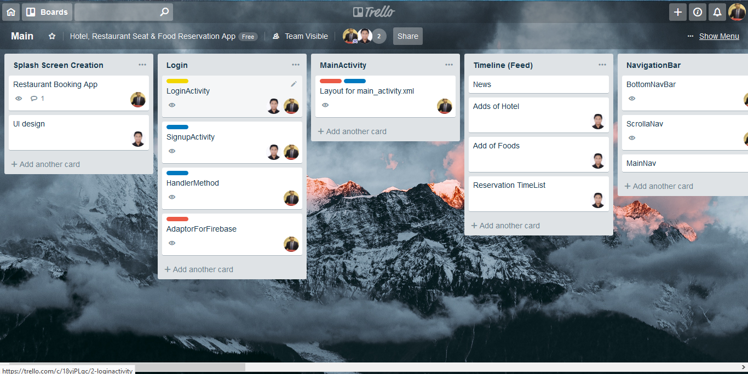

Slide 4
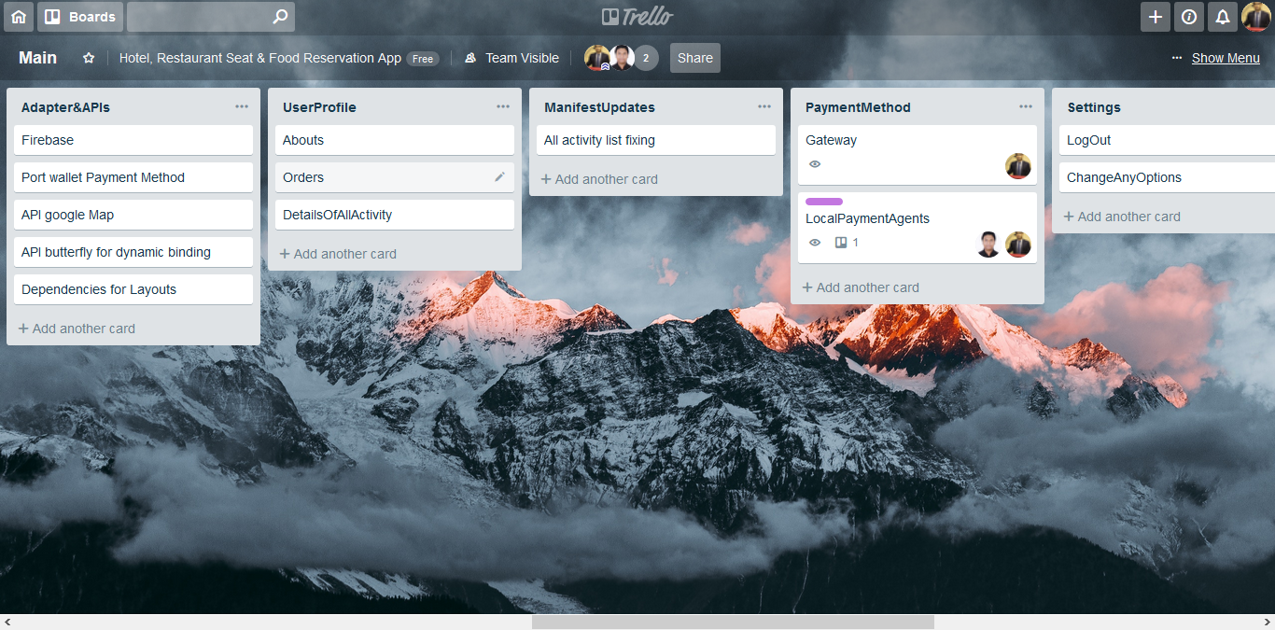

Slide 5
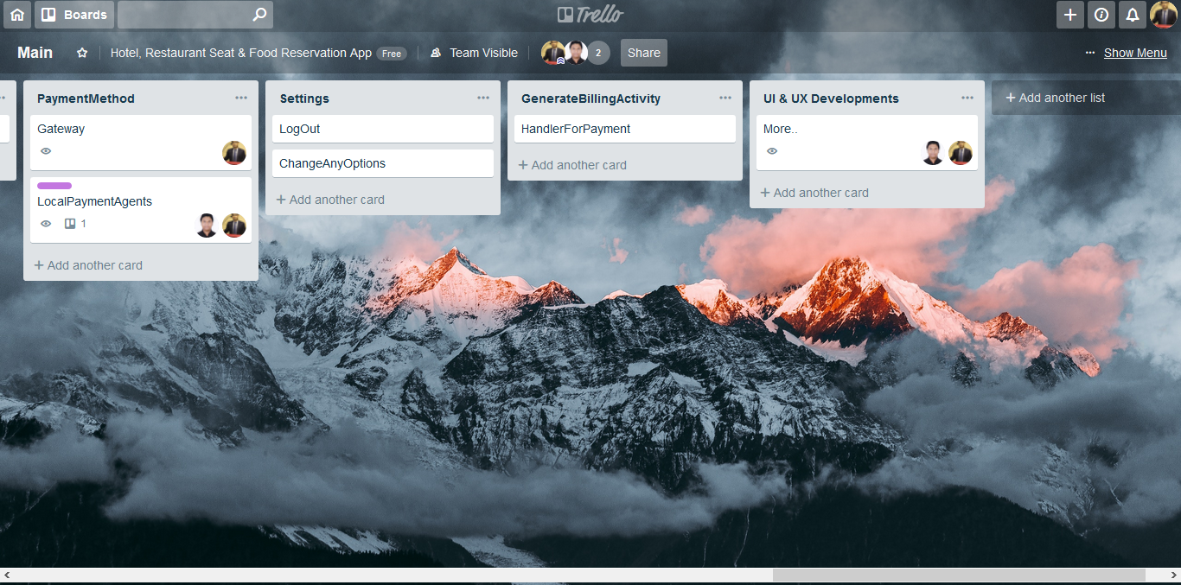

Slide 6
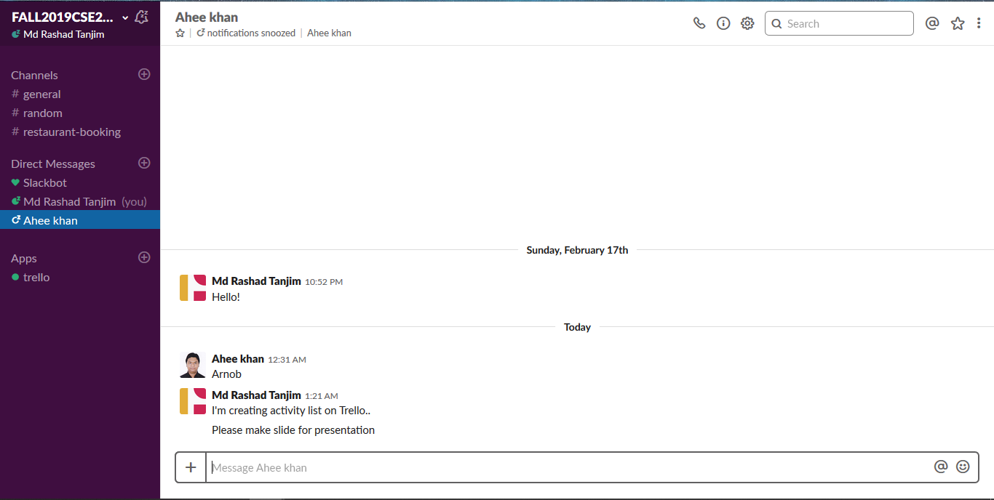

Slide 7
